Slide 1
Chapter-6 Implementation of E-Business systems
Change management
Analysis and design
Implementation and maintenance

Slide 2
INTRODUCTION CHANGE MANAGEMENT
Change management Managing process, structural, technical, staff and culture change within an organization
Approaches to managing changes to organizational processes and structures and their impact on organization staff and culture is known as change management.
Approaches to managing change associated with e-business.
Business transformation Significant changes to organizational processes implemented to improve organizational performance.
For example, the introduction of an e-business system to support online sales or online procurement may introduce major changes for staff working in these areas.
Both types of systems represent a potential threat to existing staff. Some staff may have been working face-to-face with customers or suppliers for many years and they are now asked to use technology which decreases the human element of contact.

Slide 3
The challenges of implementing and managing e-commerce
Scheduling – what are the suitable stages for introducing change?
Budgeting – how do we cost e-business?
Resources needed – what type of resources do we need, what are their responsibilities and where do we obtain them?
Organizational structures – do we need to revise organizational structure?
Managing the human impact of change – what is the best way to introduce large-scale e-business change to employees?
Technologies to support e-business change – the roles of knowledge management, groupware and intranets are explored.

Slide 4
The challenges of e-business transformation
1 Market and business model.
2 Business process.
3 Organizational structure, culture and staff responsibilities.
4 Technology infrastructure changes

Slide 5
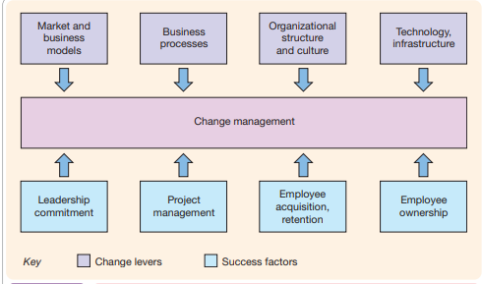
Key factors in achieving change

Slide 6
Major changes that are required in order for an organization
management buy-in and ownership;
effective project management;
action to attract and keep the right staff to achieve change;
employee ownership of change.

Slide 7
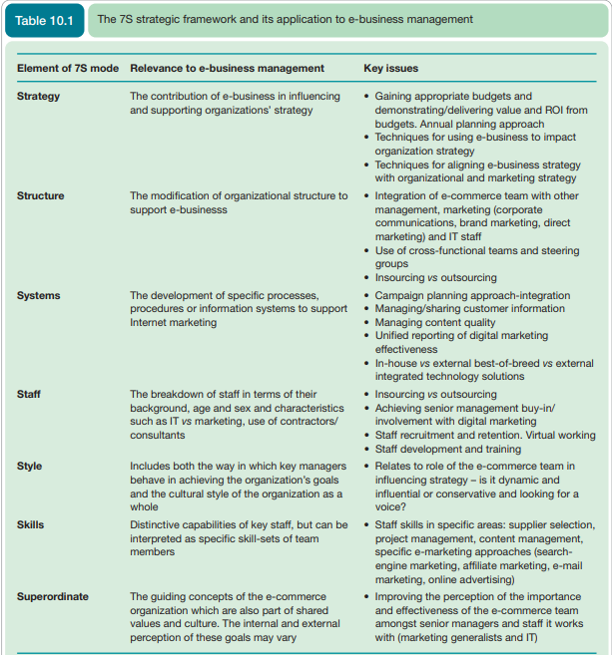
The challenges of sell-side e-commerce implementation

Slide 8
The main challenges
Strategy – Limited capabilities to integrate Internet strategy into core marketing and business strategy
Structure – Structural and process issues are indicated by the challenges of gaining resource and buy-in from traditional marketing and IT functions.
Skills and staff – These issues were indicated by difficulties in finding specialist staff or agencies.

Slide 9
The main challenges Cont..
Gaining buy-in and budget consistent with audience media consumption and value generated Conflicts of ownership and tensions between a digital marketing team, traditional marketing, IT, and finance and senior management
Coordination with different channels in conjunction with teams managing marketing programmes elsewhere in the business
Managing and integrating customer information about characteristics and behaviours collected online
Achieving a unified reporting and performance improvement process throughout the business including reporting, analysis and auctioning suggested changes
Structuring the specialist digital team and integrating into the organization by changing responsibilities elsewhere in the organization
Insourcing vs outsourcing online marketing tactics, i.e. search, affiliate, e-mail marketing, PR Staff recruitment and retention since there is a shortage of e-marketing skills given the rapid growth in demand for these skills, which gives great opportunities for everyone

Slide 10
Different types of change in business
Incremental change Relatively small adjustments required by an organization in response to its business environment.
Viewed at a large scale across an entire industry, change takes two forms. Incremental change involves relatively small adjustments required by changes in the business environment.
Organizations scan their environment and make adjustments according to the introduction of new products from competitors, new laws or long-term changes in customer behaviour such as the increasing spending power of teenagers.
Organizations also make changes to improve the efficiency of their processes.
Discontinuous change involving a major transformation in an industry
More significant discontinuous change or transformational change involves a major change in the business environment which changes the basis for competition.
The opportunities and threats presented by widespread availability of low-cost Internet connectivity is a discontinuous change.
Organizational change Includes both incremental and discontinuous change to organizations.
Organizational change mirrors that at industry level. It can occur on a continuous or incremental basis or on a discontinuous basis.
The introduction of e-business requires organizations to manage both types of change.

Slide 11
Classifying types of organizational change
Anticipatory change An organization initiates change without an immediate need to respond
This uses the concepts of incremental and discontinuous change together with anticipatory or reactive change.
Anticipatory change occurs when an organization makes proactive changes in order to improve its efficiency or to create an advantage within the competitive environment.
Reactive change A direct response by an organization to a change in its environment
Reactive change is a direct response to a change in the external environment.

Slide 12
Different forms of organizational change
1 Tuning. This is an incremental form of change when there is no immediate need for change. It can be categorized as ‘doing things better’. New procedures or policies may be used to improve process efficiency, e.g. to reduce time to market or reduce costs of doing business. E-business involves ‘tuning’ as Internet technologies are applied to improve efficiency.
2 Adaptation. Also an incremental form of change, but in this case it is in response to an external threat or opportunity. It can also be categorized as ‘doing things better’. For example, a competitor may introduce a new product or there may be a merger between two rivals. A response is required, but it does not involve a significant change in the basis for competition. Managing e-business-related change also requires adaptation.
3 Re-orientation. A significant change or transformation to the organization is identified as a priority in the short-to-medium term. There is not an immediate need for change, but a significant change is anticipation of change. When IBM was one of the first organizations to introduce the concept of ‘e-business’ in the mid-1990s, this was a re-orientation in the way it delivered its service (with an increased focus on consultancy services rather than hardware and software) which helped to spark a wider change in the way businesses worked. Successful adoption of e-business also requires re-orientation for many organizations.
4 Re-creation. In re-creation, the senior management team of an organization decides that a fundamental change to the way it operates is required to compete effectively. In the airline industry, established airlines have had to establish change programmes to respond to the low-cost carriers, for example by emphasizing service quality or introducing rival low-cost services. Both re-orientation and re-creation can be categorized as ‘doing things differently’. E-business has also caused ‘re-creation’ in the airline industry, with the low-cost airlines now gaining more than 90% of bookings online. However, as we saw in Chapter 4, such dramatic change has not been caused in every industry

Slide 13
Business process management
Business process management (BPM) An approach supported by software tools intended to increase process efficiency by improving information flows between people as they perform business tasks.
BPM is a methodology, as well a collection of tools that enables enterprises to specify step-by-step business processes.
Proper analysis and design of BPM flows require a strong understanding of the atomic business steps that must be performed to complete a business process.
As BPM executes a business process, these atomic steps will often correspond to well-known business activities, such as checking credit ratings, updating customer accounts and checking inventory status.
In effect, the BPM process flow is often just a sequence of well-known services, executed in a coordinated fashion.
Classic document workflow, which was BPM’s predecessor, focused on humans performing the services.
Fueled by the power of application integration, BPM focuses on human and automated agents doing the work to deliver the services.

Slide 14
Discontinuous process change
Business process re-engineering (BPR) Identifying radical, new ways of carrying out business operations, often enabled by new IT capabilities.
The essence of BPR is the assertion that business processes, organizational structures, team structures and employee responsibilities can be fundamentally altered to improve business performance.
The fundamental rethinking and radical redesign of business processes to achieve dramatic improvements in critical, contemporary measures of performance, such as cost, quality, service, and speed.

Slide 15
The BPR concept
Fundamental rethinking – re-engineering usually refers to changing of significant business processes such as customer service, sales order processing or manufacturing.
Radical redesign – re-engineering is not involved with minor, incremental change or automation of existing ways of working. It involves a complete rethinking about the way business processes operate.
Dramatic improvements – the aim of BPR is to achieve improvements measured in tens or hundreds of per cent. With automation of existing processes only single-figure improvements may be possible.
Critical contemporary measures of performance – this point refers to the importance of measuring how well the processes operate in terms of the four important measures of cost, quality, service and speed.
Business process improvement (BPI) Optimizing existing processes, typically coupled with enhancements in information technology.
Business process automation (BPA) Automating existing ways of working manually through information technology.

Slide 16
Analysis and design
Analysis of system requirements and design for creation of a system.
In the context of strategy implementation, analysis and design activities are required to specify the business and user needs for a system and to develop a plan for building it.
Analysis for e-business Using analytical techniques to capture and summarize business and user requirements.

Slide 17
Workflow management
Workflow management (WFM) The automation of information flows and provides tools for processing the information according to a set of procedural rules.
The automation of a business process, in whole or part during which documents, information or tasks are passed from one participant to another for action, according to a set of procedural rules
Workflow software provides functions to:
assign tasks to people
remind people about their tasks which are part of a workflow queue
allow collaboration between people sharing tasks
retrieve information needed to complete the task such as a customer’s personal details
provide an overview for managers of the status of each task and the team’s performance.

Slide 18
What type of workflow applications will exist in a company? For a B2B company, e-business applications of workflow might include:
1 Administrative workflow. This concerns internal administrative tasks. Examples include managing purchase orders for procurement and booking holidays and training.
2 Production workflows. These are customer-facing or supplier-facing workflows. An intranetor extranet-based customer support database and stock management system integrated with a supplier’s system is an example of production workflow.

Slide 19
Process modelling
Process Part of a system that has a clearly defined purpose or objective and clearly defined inputs and outputs
The processes and sub-processes are essentially the activities or tasks that need to be performed by the business information system, so these are sometime referred to as ‘activity-based process definition methods’.
Activity-based process definition methods Analysis tools used to identify the relationship between tasks within a business process
A process can be defined at the business level in terms of the main activities of a business.
Each process can be broken down further as explained in the section on Task analysis and task decomposition.
Significant business processes are elements of the value chain; they include inbound logistics (including procurement), manufacture, outbound logistics or distribution, and customer relationship management or sales and marketing activity.
Process mapping Identification of location and responsibilities for processes within an organization

Slide 20
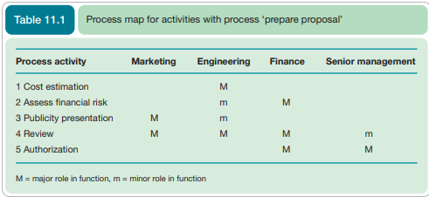
Task analysis and task decomposition
Task analysis Identification of different tasks, their sequence. and how they are broken down

Slide 21
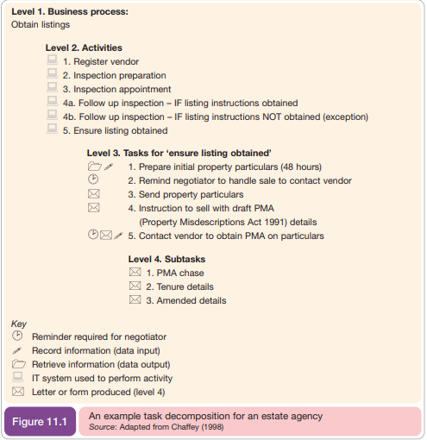

Slide 22
1 Business process. A set of one or more linked procedures or activities which collectively realize a business objective or policy goal, normally within the context of an organizational structure defining functional roles and relationships.
2 Activity. A description of a piece of work that forms one logical step within a process. An activity may be a manual activity, which does not support computer automation, or a workflow (automated) activity. A workflow activity requires human and/or machine resource(s) to support process execution; where human resource is required an activity is allocated to a workflow participant.
3 Work item. The representation of the work to be processed (by a workflow participant) in the context of an activity within a process instance. An activity typically generates one or more work items which together constitute the task to be undertaken by the user (a workflow participant) within this activity. Process dependencies.

Slide 23
Data modelling
data modelling for e-commerce is to use examples that identify typical elements of data modelling for a sell-side e-commerce system.
Use ER (entity relationship) modelling to review typical structures for these databases.
In simple ER modelling there are three main stages.
1 Identify entities. Entities define the broad groupings of information such as information about different people, transactions or products. Examples include customer, employee, sales orders, purchase orders. When the design is implemented each design will form a database table.
2 Identify attributes for entities Entities have different properties known as ‘attributes’ that describe the characteristics of any single instance of an entity. For example, the customer entity has attributes such as name, phone number and e-mail address. When the design is implemented each attribute will form a field, and the collection of fields for one instance of the entity such as a particular customer will form a record.
3 Identify relationships between entities The relationships between entities require identification of which fields are used to link the tables. For example, for each order a customer places we need to know which customer has placed the order and which product they have ordered.

Slide 24
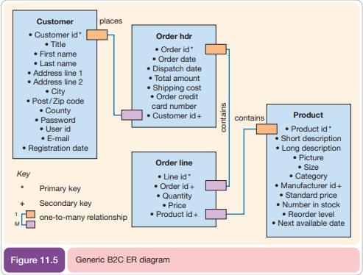

Slide 25
Design for e-business
The design element of creating an e-business system involves specifying how the system should be structured.
System design Defines how an information system will operate.

Slide 26
Architectural design of e-business systems
The starting point for design of e-business systems is to ensure that a common architecture exists across the company in terms of hardware and software technology, applications and business processes.
Client–server model A system architecture in which end-user machines such as PCs, known as ‘clients’, run applications while accessing data and possibly programs from a server.
E-business vs ERP architectures ‘Designing an appropriate architecture for e-business is effectively the same as the architecture for enterprise resource planning systems.
Data storage. Predominantly on server. Client storage is ideally limited to cookies for identification of users and session tracking. Cookie identifiers for each system user are then related to the data for the user which is stored on a database server. Query processing. Predominantly on the server, although some validation can be performed on the client.
Display. This is largely a client function.
Application logic. Traditionally, in early PC applications this has been a client function, but for e-business systems the design aim is to maximize the application logic processing including the business rules on the server

Slide 27
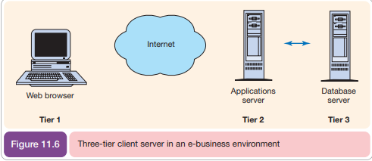
E-business Architecture
Three-tier client– server The first tier is the client that handles display, second is application logic and business rules, third is database storage.
A typical e-business architecture uses a three-tier client–server model where the client is mainly used for display with application logic and the business rules partitioned on a server, which is the second tier, and the database server is the third tier. Since most of the processing is executed on the servers rather than the client, this architecture is sometimes referred to as a ‘thin client’, because the size of the executable program is smaller.
Thin client An end-user access device (terminal) where computing requirements such as processing and storage (and so cost) are minimize
The application server provider (ASP) is typically based upon the three-tier model.

Slide 28
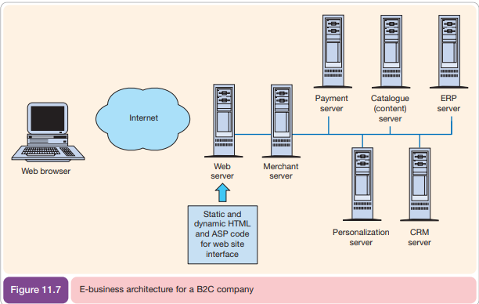
E-Business Architecture for B2C company
Web server. Manages http requests from client and acts as a passive broker to other servers. Returns or serves web pages.
Merchant server. This is the main location of the application logic and integrates the entire application by making requests to the other server components.
Personalization server. Provides tailored content – may be part of commerce server functionality. Payment commerce server. Manages payment systems and secure transactions.
Catalogue server. A document management server used to display detailed product information and technical specifications.
CRM server. Stores information on all customer contacts.
ERP server. Required for information on stock availability and pricing from the customer. Will also need to be accessed for sales order processing and histories. Logistics for distribution will also be arranged through the ERP server.

Slide 29
User-centred site design
Since e-business systems are often customer- or employee-facing systems, the importance of human–computer interaction is high in the design of web applications.
User-centred design
Design based on optimizing the user experience according to all factors, including the user interface, which affect this.
Unless a web site meets the needs of the intended users it will not meet the needs of the organization providing the web site. Web site development should be user-centred, evaluating the evolving design against user requirements.
User-centred design starts with understanding the nature and variation within the user groups.
Who are the important users?
What is their purpose in accessing the site?
How frequently will they visit the site?
What experience and expertise do they have?
What nationality are they? Can they read English?
What type of information are they looking for?
How will they want to use the information: read it on the screen, print it or download it?
What type of browsers will they use? How fast will their communication links be?
How large a screen/window will they use, with how many colours?

Slide 30
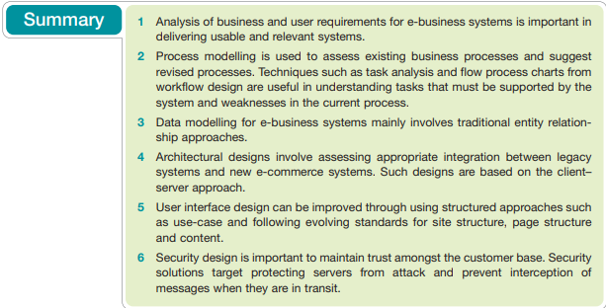

Slide 31
Implementation and maintenance
Implementation The creation of a system based on analysis and design documentation.
The implementation stage can be relatively straightforward: simply implementing the design.
Implementation activities The creation of the system modules by coding and scripting, module integration and testing and changeover to the live system.
However, even with the best design, it is still necessary to follow implementation activities that test the system thoroughly and manage the transition or changeover from the old system to the new system or the launch of the site.
Note that there is also a broader use of the term ‘implementation’ which is used to describe the implementation of strategy.
Once an e-business application or e-commerce site is live, the maintenance phase is arguably of more significance than in traditional business application development since a successful application is dynamic.
A dynamic e-business application means that content and services will be continuously updated in response to the environmental scanning.
As competitors introduce new services and offers, and as marketing research reveals problems with the site from a customer perspective, or new opportunities, maintenance activities will be required for the e-business to remain competitive.

Slide 32
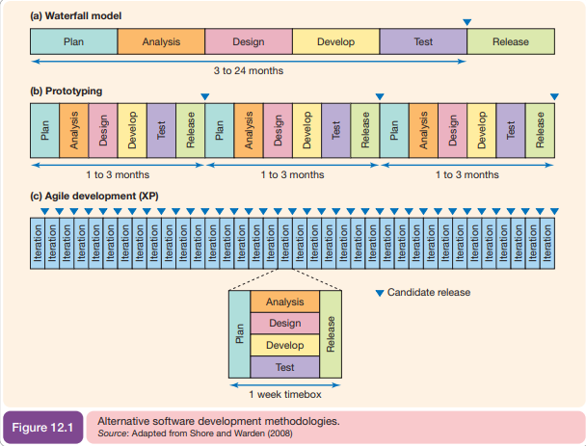

Slide 33
Alternatives for acquiring e-business systems
Acquisition method Defines whether the system is purchased outright or developed from scratch.
The basic alternative acquisition methods for e-business systems are similar to those for traditional business information systems:
1 Bespoke development. With a bespoke development, the application is developed from ‘scratch’ through programming of a solution by an in-house or external development team or systems integrator.
2 Off-the-shelf. In a packaged implementation a standard existing system is purchased from a solution vendor and installed on servers and clients located within the organization. Alternatively, free or low-cost open-source software may be used. A web design tool such as Dreamweaver is a simple example of an off-the-shelf packaged implementation.
3 Hosted software as a service (SaaS) solution. With a hosted solution, a standard system is used, but it is not managed within the company, but using a third-party applications service provider variously known as ‘on-demand’, ‘web services’ or a ‘managed solution’.
4 Tailored development. In a tailored development, an off-the-shelf system or SaaS solution is tailored according to the organization’s needs. This form of project is often based on integrating components from one or several vendors

Slide 34
The Source of the system and selection of Solutions
1 Functionality. The features of the application. Describes how well the e-business application meets the business need.
2 Ease of use. Every system takes some time to use, but systems should be intuitive to minimize the time needed to learn how to use them. A well-constructed piece of software will make it fast to conduct common tasks.
3 Performance. The speed of the application to perform different functions. This is measured by how long the user has to wait for individual functions to be completed such as data retrieval, calculation and screen display. It will depend on the power of the computer, but can vary significantly between applications.
4 Scalability. Scalability is related to performance; it describes how well a system can adapt to higher workloads which arise as a company grows. For example, an ERP system will require more customer details, suppliers and products to be held on it as the company grows. The workload will also be higher as the number of internal and external users of the system increases.
5 Compatibility or interoperability. This refers to how easy it is to integrate the application with other applications. For example, does it have import and export facilities, does it support transfer of data using XML?
6 Extensibility. Related to scalability and interoperability, this describes how easy it is to add new functions or features to a package by adding new modules from the original vendor or other vendors.
7 Stability or reliability. All applications have errors or bugs and applications vary in the number of times they fail depending on how well they have been tested since they were first introduced.
8 Security. Capabilities for restricting access to applications should be assessed. This is particularly important for hosted solutions.
9 Support. Levels of support and the cost of support from the software vendor will vary. There is a risk that small companies may cease trading and the product may no longer be supported

Slide 35
Testing & Testing process
Testing Aims to identify non-conformance in the requirements specification and errors.
Testing has two main objectives: first, to check for non-conformance with the business and user requirements, and, second, to identify bugs or errors.
In other words, it checks that the site does what users need and is reliable.
Testing is an iterative process that occurs throughout development.
As non-conformances are fixed by the development team, there is a risk that the problem may not have been fixed and that new problems have been created.
Further testing is required to check that solutions to problems are effective.
A structured testing process is necessary in order to identify and solve as many problems as possible before the system is released to users.
This testing is conducted in a structured way by using a test specification which is a comprehensive specification of testing in all modules of the system.

Slide 36
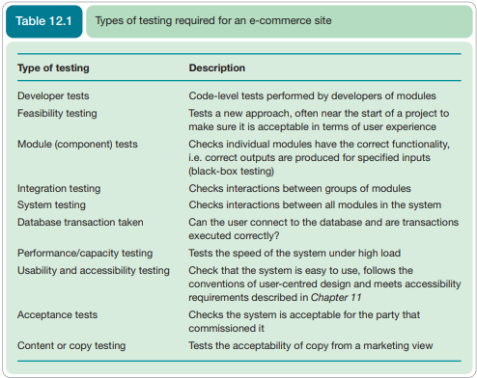

Slide 37
Database creation and data migration
Data migration Transfer of data from old systems to new systems.
A final aspect of changeover that should be mentioned, and is often underestimated, is data migration.
For an e-commerce system for a bank, for example, this would involve transferring or exporting data on existing customers and importing them to the new system.
This is sometimes also referred to as ‘populating the database’. Alternatively, a middleware layer may be set up such that the new system accesses customers from the original legacy database.
Before migration occurs it is also necessary for a member of the development team known as ‘the database administrator’ to create the e-commerce databases. This can be time consuming since it involves:
Creating the different tables by entering the field definitions arising from the data modelling .
Creating the different roles of users such as their security rights or access privileges. These need to be created for internal and external users.
Creating stored procedures and triggers, which is effectively server-side coding to implement business rules.
Optimizing the database for performance.

Slide 38
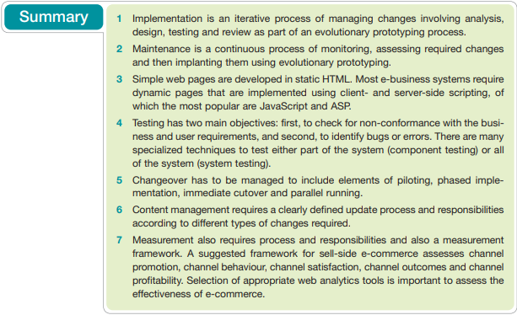

Slide 39
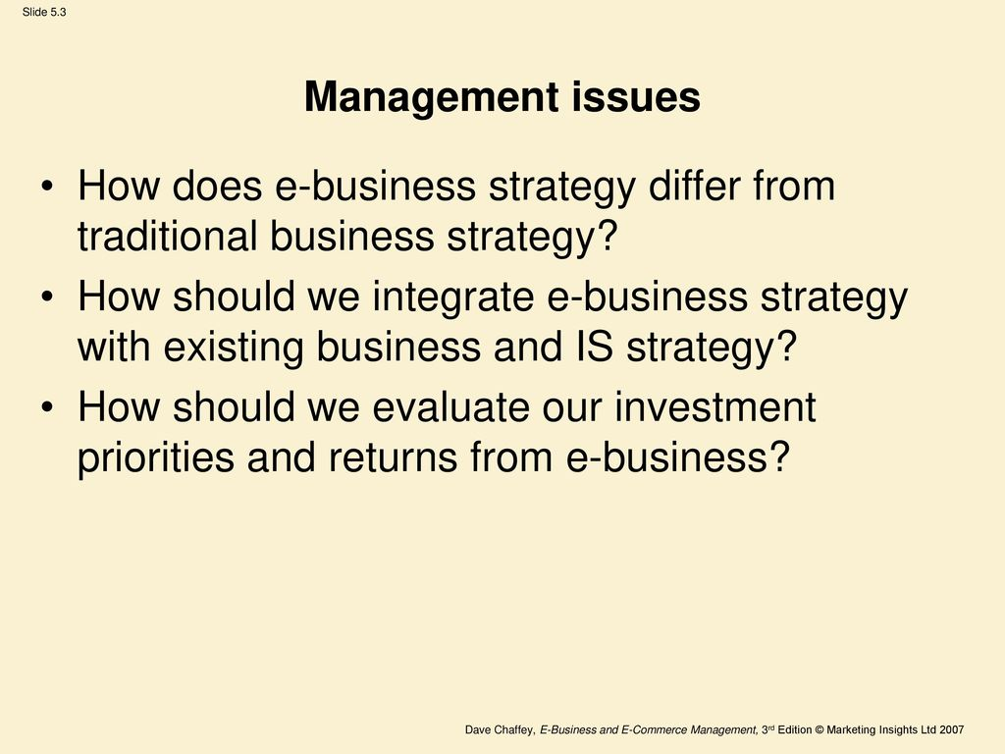
Group presentation Topics

Slide 40
Presentation topics
Change Management Strategies for Digital Transformation
Change Management In e Commerce
III. Evaluating E-Commerce Business Transformation Models and Strategies
1.Current Problems of Change Management in Digital Transformation
2. Change Management Strategies for SMBs
3. Make Sure the Change Is Necessary and Desirable
4. Minimize Disruption
5. Promote Communication
6. Recognize That Change Is the Norm, Not the Exception

